Slide 1

Data-Driven Healthcare: SQL Queries for Effective Patient Management

Slide 2
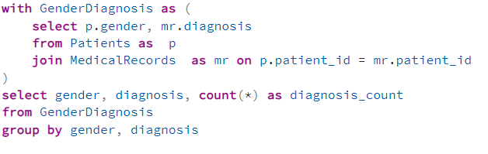
Diagnoses by Gender Using CTE(Common table expressions) Question: Count the number of diagnoses by gender using a CTE(common table expressions).

Slide 3
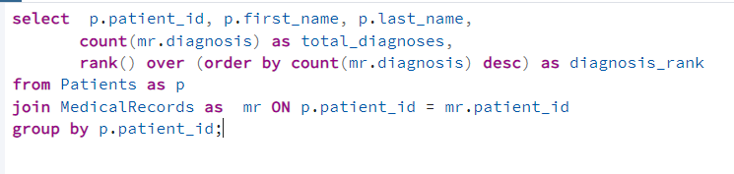
Total Diagnoses and Rank by Patient Using Window Functions Question: List patients with the total number of diagnoses and rank them.

Slide 4
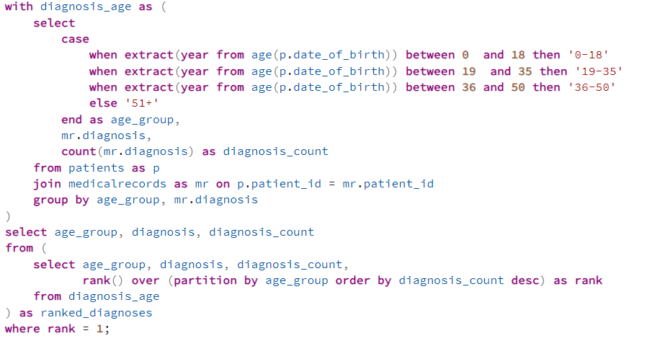
Most Common Diagnosis by Age Group Using CTE Question: Find the most common diagnosis for each age group using a CTE.

Slide 5
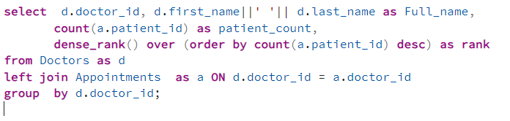
Ranking Doctors by Patient Count Using Window Functions Question: Rank doctors based on the number of patients they are treating.

Slide 6
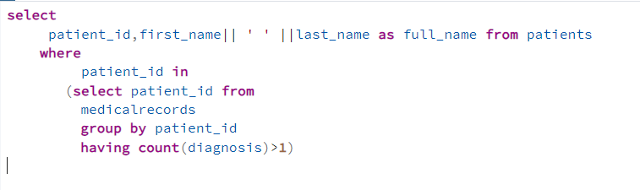
Patients with More Than One Diagnosis Question: Find patients who have more than one diagnosis using a subquery.

Slide 7
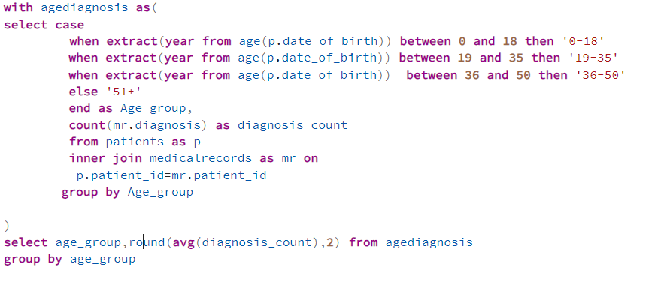
- Average Diagnosis by Age Group Using CTE Question: Calculate the average number of diagnoses for each age group using a CTE.

Slide 8
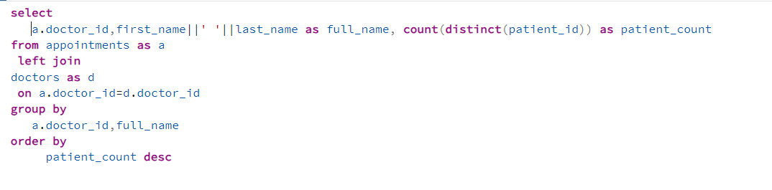
List doctors along with the number of patients they are currently treating.

Slide 9
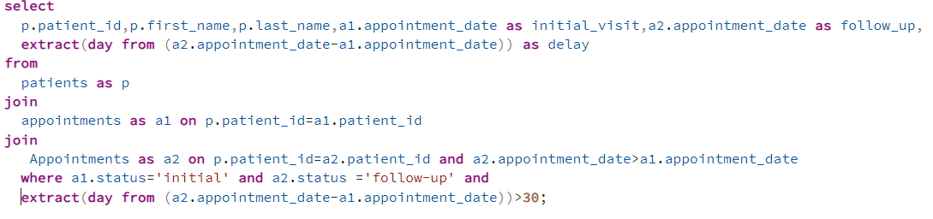
Follow-up Appointment Delay Find patients who had their follow-up appointments delayed by more than 30 days.

Slide 10
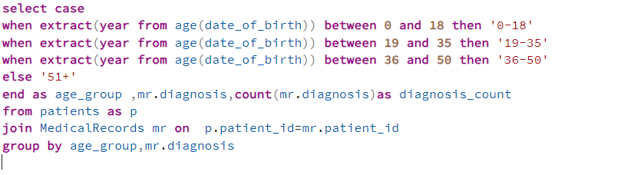
Diagnosis by Age Group Create age groups (e.g., 0-18, 19-35, 36-50, 51+) and count diagnoses in each group.

Slide 11
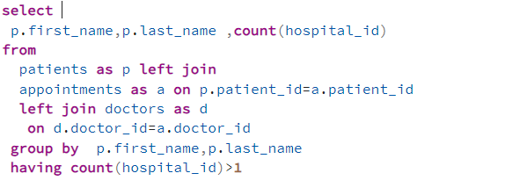
Common Patients Across Hospitals Find patients who have appointments at more than one hospital.

Slide 12
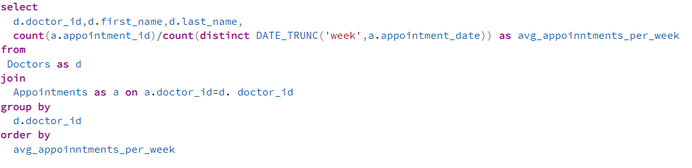
Doctors by Appointment Rate Rank doctors by the average number of appointments they have scheduled per week.

Slide 13
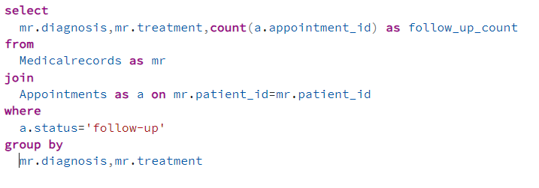
- Comparison of Treatment Effectiveness Analyze and compare the number of follow-up visits for patients treated with different treatments for the same condition.

Slide 14
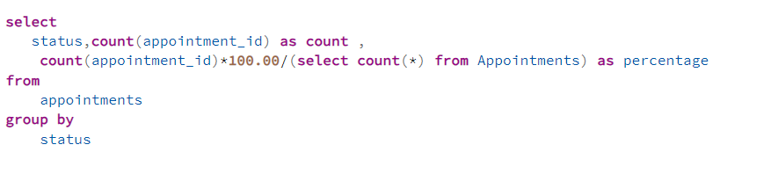
Appointment Status Analysis For each status (scheduled, completed, cancelled), show the percentage of total appointments.

Slide 15
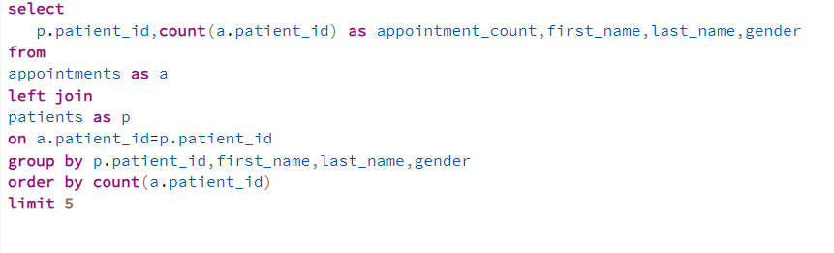
Top 5 Patients by Appointment Count Identify the top five patients with the most appointments, showing their details.

Slide 16
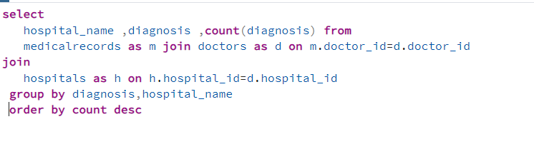
Diagnosis Frequency for Each Hospital Count the frequency of diagnoses made at each hospital and sort them by the count.

Slide 17
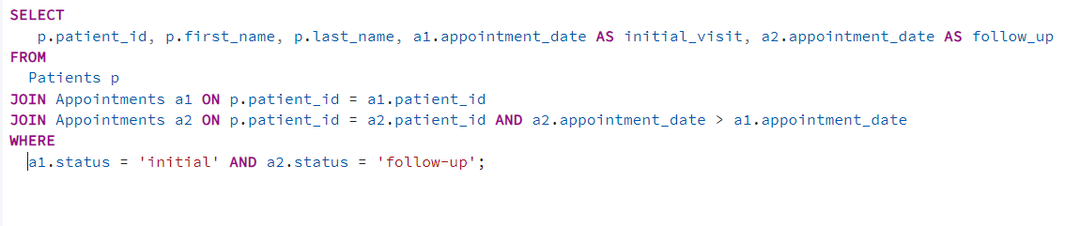
Follow-up Appointments Retrieve a list of patients who have a follow-up appointment scheduled after their initial visit

Slide 18
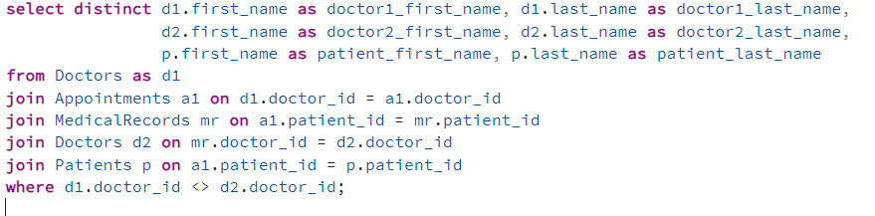
Doctors Treating Same Patient List doctors who have treated the same patient, showing their names and the patient's details.

Slide 19
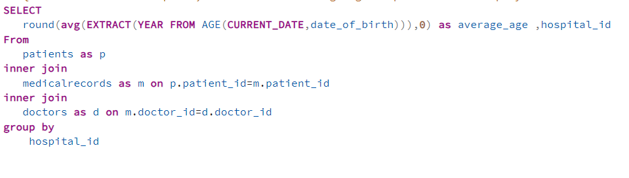
-Hospital Patient Age Distribution For each hospital, calculate the average age of patients and display the results.

Slide 20
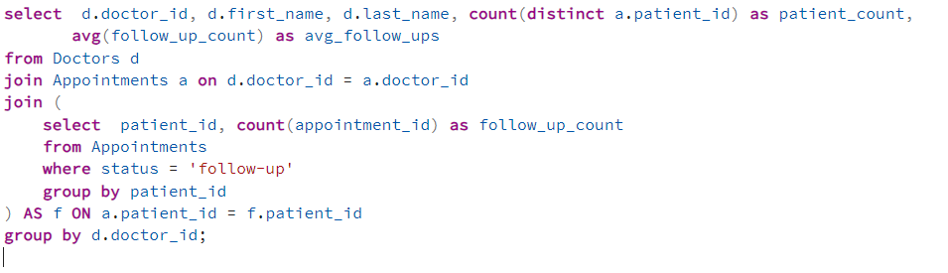
Doctor Performance For each doctor, count the number of patients seen and average the number of follow-up appointments per patient.

Slide 21
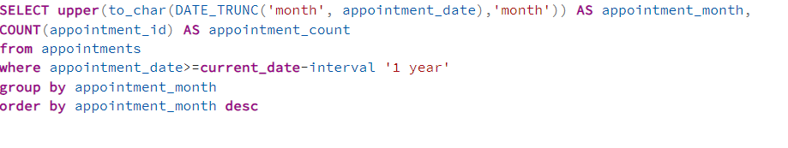
Appointment Trends Over Time Generate a report showing the number of appointments scheduled per month for the past year.

Slide 22
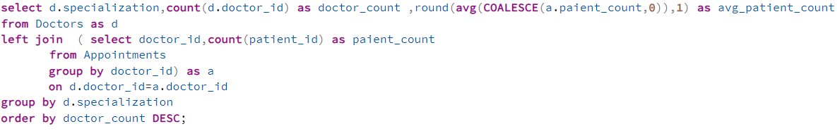
Top Specializations Identify which specialization has the highest number of doctors and the average number of patients each doctor sees.

Slide 23
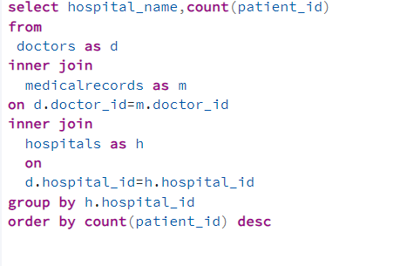
Hospitals with Highest Patient Count List the hospitals sorted by the number of patients they have, including the count.

Slide 24
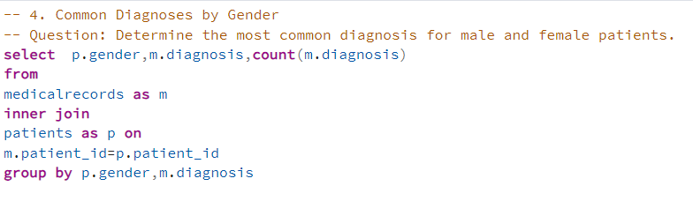
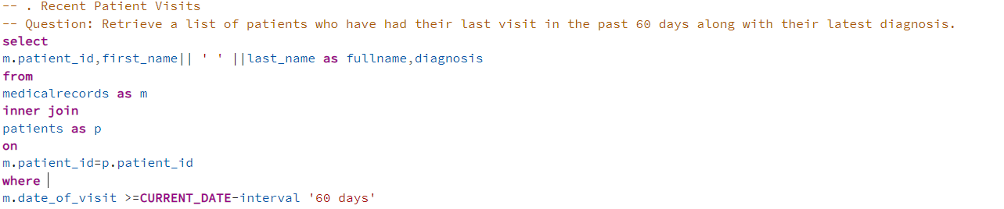

Slide 25
